Slide 1

KNOWLEDGE INSTITUTE OF TECHNOLOGY, SALEM – 637504
(Autonomous Institution)
MAP
2025
Third Review
Batch No.: 02
Club Name: SMART AUTOMATION CLUB
Team Members: B. Dharaneshwaran, A. Harish, R. Dharaneesh, R. Gokilnathan
Full Affiliation: III Year MECH, Knowledge Institute of Technology. Salem.
Name of the Mentor: Prof K.N. Karthick
Presentation Date: 08/04/2026

Slide 2
Table of Content
• Mentor Interaction and Suggestion Received
• Refining MVP based on Mentor Suggestions
• Refining MVP based on GTC approach
• MVP Prototype Development
• First Iteration using GTC to enhance MVP

Slide 3
Mentor Interaction and Suggestion Received
Present initial design with conventional blade system.
Mentor identified key issues:
  Design was slightly complex
  Blade system had maintenance and safety concern
Suggestions given:
  Simplify Mechanism
  Improve Safety
Decided to explore alternative blade concept.

Slide 4
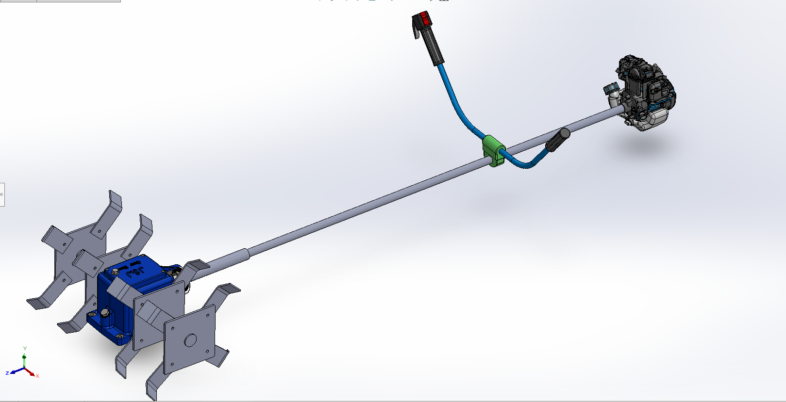
Refining MVP based on Mentor Suggestions
Old Design:
Used traditional cutting blade
Higher maintenance
Safety risk
Slightly complex fabrication
Updated Design:
Replaced blade with spiked disc (bolt-nut type)
Easy to replace and maintain
Safer operation
Simplified structure
`
“Mentor suggestions led to a safer and simpler design transition”

Slide 5

Refining MVP based on GTC approach
Conducted interaction with farmers (GTC)
Feedback received:
  Heavy machines are difficult to handle
  Need simple and portable solution
Improvements Based on GTC:
  Introduced replaceable bolt-type-spikes
  Improved ease of handling
“Customer feedback validated the updated design choice”

Slide 6
MVP Prototype Development
Developed prototype based on updated design
Components:
  Motor
  Shaft
  Spiked disc
Prototype confirms:
  Simple working
  Feasible design
“Prototype built based on improved design concept”

Slide 7
First Iteration using GTC to enhance MVP
Initial model tested
Observations:
  Traditional blade not effective
  Handling issues
Shifted to spiked disc mechanism
Improved
  Stability
  Safety
  Maintenance
  “Iteration resulted in final optimized design”

